Slide 1
Heisenberg Uncertainty Principle
Considering a moving particle as a wave group implies that there are fundamental limits to the accuracy with which we can measure such “particle” properties as position and momentum.

Slide 2
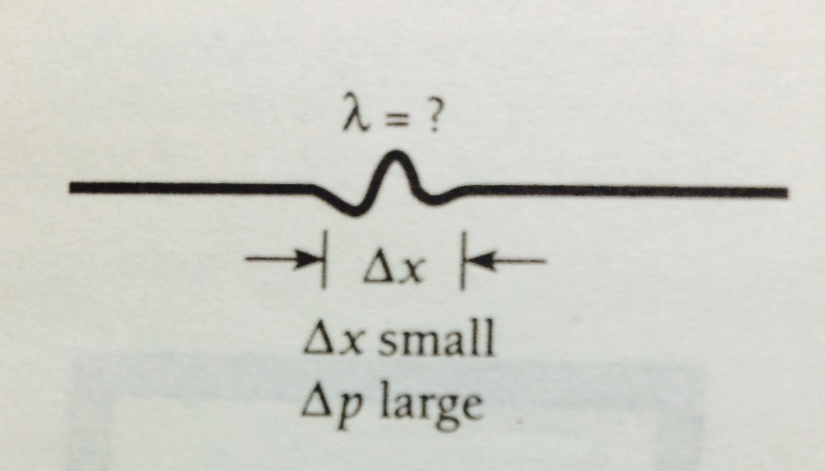
The narrower its wave group, the more precisely a particle’s position can be specified as shown in Fig. However, the wavelength of the waves in a narrow packet is not well defined; there are not enough waves to measure λ accurately. This means that since λ=h/mv, the particle’s momentum mv is not a precise quantity. If we make a series of momentum measurements, we will find a broad range of values.

Slide 3
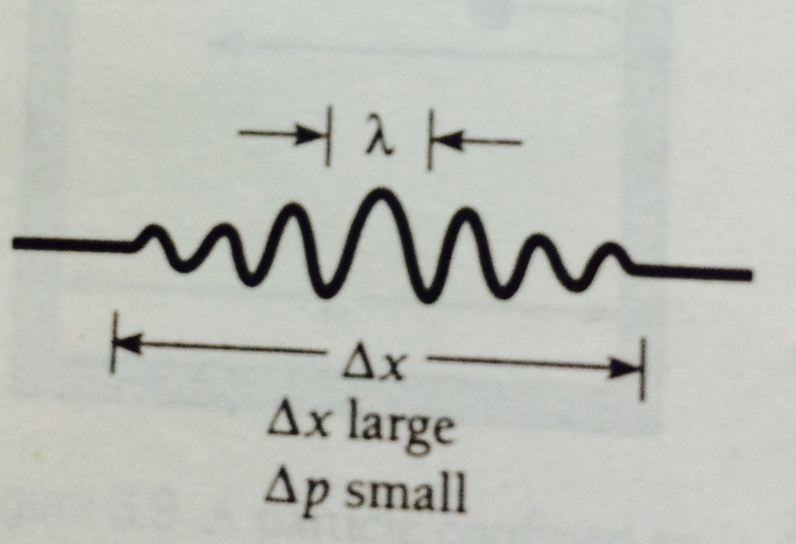
On the other hand, a wide wave group, such as that in Fig., has a clearly defined wavelength. The momentum that corresponds to this wavelength is therefore a precise quantity, and a series of measurements will give a narrow range of values. But the width of the group is now too great for us to be able to say exactly where the particle is at a given time.

Slide 4
This principle, which was discovered by Werner Heisenberg in 1927, is one of the most significant of physical laws.
It states that “It is impossible to know both the exact position and exact momentum of an object at the same time”.

Slide 5
Heisenberg has shown that if we design even an ideal experiment to measure simultaneously the position x and momentum p of a particle, there will be an uncertainty of ∆x in the position and an uncertainty of ∆p in the momentum such that
∆x ∆p ≥ h/4π

Slide 6
If one quantity is tried to be measured exactly, the other will become completely uncertain, and vice-versa. Let us illustrate the principle by simple experiments:

Slide 7
Determination of the position of a particle by a Microscope
Suppose we imagine to determine accurately the position and momentum of an electron e along the x-axis, using an ideal microscope free from all mechanical and optical defects. If the particle were completely isolated from external influences, then the two determinations of its exact positions at exactly measured times would give its exact velocity (and hence momentum).

Slide 8
But a completely isolated particle can not be detected. We must at least illuminate it.
Suppose we look at an electron using light of wavelength λ as in Fig.

Slide 9
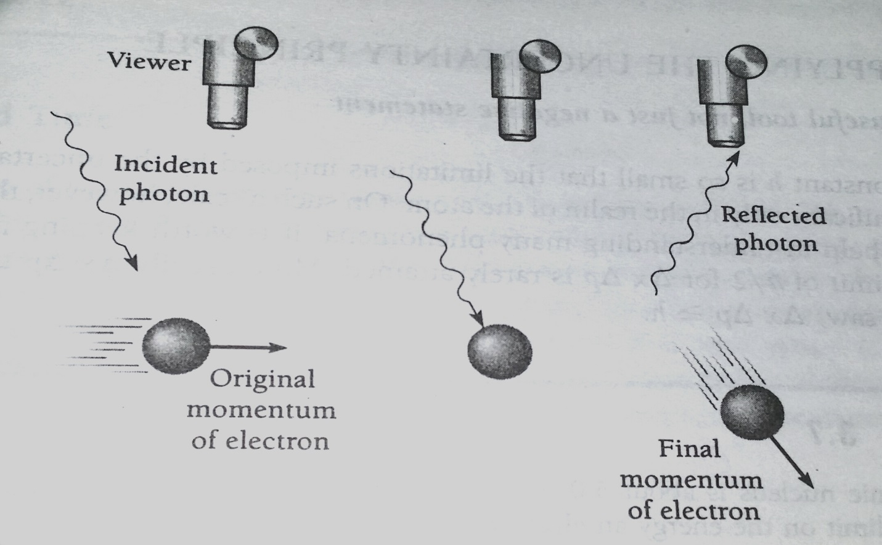

Slide 10
Each photon of this light has the momentum h/λ. When one of these photons bounces off the electron (which must happen if we are to “see” the electron), the electron’s original momentum will be changed. The exact amount of the change Δp cannot be predicted, but it will be of the same order of magnitude as the photon momentum h/λ. Hence

Slide 11

…………………(1)
The longer the wavelength of the observing photon, the smaller the uncertainty in the electron’s momentum.

Slide 12
Because light is a wave phenomenon as well as a particle phenomenon, we cannot expect to determine the electron’s location with perfect accuracy regardless of the instrument used. A reasonable estimate of the minimum uncertainty in the measurement might be one photon wavelength, so that
……..(2)

Slide 13
The shorter the wavelength, the smaller the uncertainty in location. However, if we use light of short wavelength to increase the accuracy of the position measurement, there will be a corresponding decrease in the accuracy of the momentum measurement because the higher photon momentum will disturb the electron’s motion to a greater extent.

Slide 14
Light of long wavelength will give a more accurate momentum but a less accurate position.
Combining Eqs. (1) and (2) gives
This result is consistent with Eq. ∆x ∆p ≥ h/4π

Slide 15
The Heisenberg’s uncertainty principle can also be expressed in terms of the uncertainties involved in the measurement of energy and time. For this, we may consider the observation made over a period of time on the energy emitted by an atom. If the uncertainties involved in the measurement of energy and time are ΔE and Δt respectively, then the uncertainty principle can be expressed as:
∆E ∆t ≥ h/4π

